Slide 1
Module 1: Lesson 5 Big Data Benefits

Slide 2
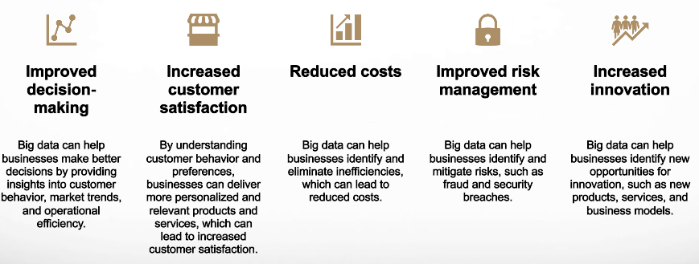
Big Data Benefits… For Stakeholders

Slide 3
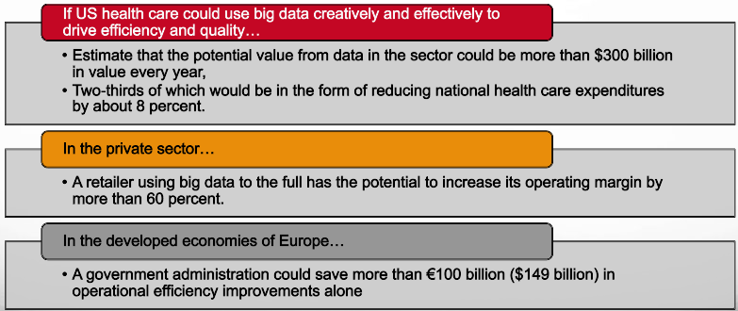
Big Data Benefits… For Stakeholders
[Source: McKinsey]

Slide 4
Big Data Benefits… For the Data Scientist
Relied on to facilitate better better decisions
Big data scientists can help businesses make better decisions by providing them with insights into their data. This can help businesses to improve their products and services, to identify new opportunities, and to reduce costs.
Known as someone who can solve complex problems
Big data scientists can help businesses to solve complex problems by using their knowledge of data analysis and machine learning. This can help businesses to improve their operations, to comply with regulations, and to protect their customers.
Turned to for critical thought leadership
Big data scientists can help businesses to drive innovation by using their knowledge of data to develop new products and services. This can help businesses to stay ahead of the competition and to grow their businesses.
Highly influential with leaders and decision makers
Big data scientists can influence others by sharing their knowledge and insights with them. This can help businesses to adopt new technologies and to improve their data-driven decision-making.

Slide 5
scientia potentia est (knowledge is power) Sir Francis Bacon English Philosopher and Statesman

Slide 6
If we have data, let’s look at data. If all we have are opinions, let’s go with mine. Jim Barksdale CEO of Netscape COO of FedEx Board Member of Time Warner Net worth: US$ 700 Million

Slide 7
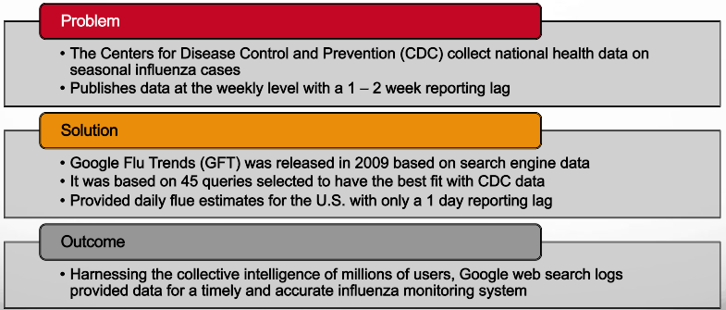
A Cautionary Story – The Beginning

Slide 8
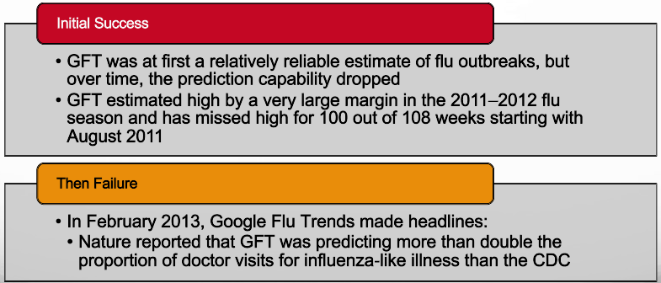
A Cautionary Story – Dark Cloud Gather

Slide 9
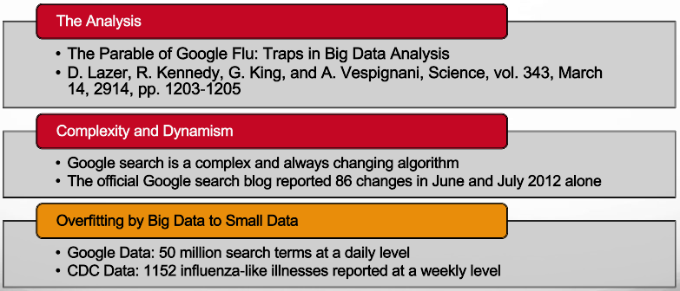
A Cautionary Story – What Happened

Slide 10
A Cautionary Story – What is Hubris?
Exaggerated pride or self-confidence
The ancient Greeks considered hubris a dangerous character flaw capable of provoking the wrath of the gods
In classical Greek tragedy, hubris was often a fatal shortcoming that brought about the fall of the tragic hero
[Source: https://dictionary.cambridge.org/us/dictionary/english/data]

Slide 11
A Cautionary Story – Big Data Hubris
“Big data hubris” is the often implicit assumption that big data are a
substitute for, rather than a supplement to, traditional data collection
and analysis
Quantity of data does not mean that one can ignore foundational
issues of measurement and construct validity and reliability and
dependencies among data
The core challenge is that most big data that have received popular
attention are not the output of instruments designed to produce valid
and reliable data amenable for scientific analysis
[Source: https://dictionary.cambridge.org/us/dictionary/english/data]

